Slide 1


LEONG YEE FAI
10/02/2025

Slide 2

Outline
Executive Summary
Introduction
Methodology
Results
Conclusion
Appendix

Slide 3
Executive Summary
Summary of methodologies
Data of Falcon 9 first stage landings from 2010 to 2020 from a public API (https://api.spacexdata.com/ ) unaffiliated with SpaceX and from the publicly available data on Wikipedia (https:// en.wikipedia.org/wiki/SpaceX) were collected by web scrapping method. Furthermore, additional data sets were provided with the course.
Data cleaning / wrangling included extracting landing outcome data to serve as the dependent variable for the machine learning models.
SQL queries and data visualizations, including static plots, interactive maps, and an interactive dashboard, were used to discover insights about the dataset.
Predictive analysis was performed using the following machine learning models: Logistic Regression, Support Vector Machine (SVM), Decision Tree, and k-Nearest Neighbors (KNN). Its then all the model were done with comparison on accuracy.
Summary of all results
The data of the SpaceX Falcon 9 first stage landings include the flight number, date of launch, payload mass, orbit type, launch site, and mission outcome.
Decision Tree had the highest accuracy while Logistic Regression, SVM, and KNN all performed equally well on this dataset for predictive purposes.

Slide 4
Introduction
Background
SpaceX advertises Falcon 9 rocket launches on its website, with a cost of 62 million dollars; other providers cost upward of 165 million dollars each, much of the savings is because SpaceX can reuse the first stage. Therefore, by determine if the first stage will successfully land, we can determine the cost of a launch. This information can be used if an alternate company wants to bid against SpaceX for a rocket launch.
Business Problem
What is the nature and extent of the available data about SpaceX Falcon 9 first stage landings?
Which machine learning model would work best (have the highest accuracy) to predict the outcome of a Falcon 9 first stage landing from a future launch?
Will future Falcon 9 first stage landing be 100% successful?

Slide 5

Section 1

Slide 6
Methodology
First stage data of SpaceX Falcon 9 landings was collected from multiple source as public API, unaffiliated with SpaceX as well as Wikipedia article. Additional data sets were provided with the course in CSV file format.
Data was prepared by wrangled and cleaned for visualizations, queries, and machine learning model training
Exploratory Data Analysis (EDA) was performed using data visualizations and SQL.
Interactive data visualizations were created using Folium and Plotly Dash.
Predictive analysis using classification models was done using machine learning models

Slide 7
Data Collection
3 type of data source, SpaceX API, Wikipedia and additional data provided by the course.
Each of the data format had undergo different method of data cleaning and data restructure by data collection , web scraping and data wrangling method to prepare for data visualization.
1
2
3
SpaceX API
Json
Wikipedia
HTML
CSV 1
Dataset_part1.csv
Data Collection- REST call
Web Scraping
Data Wrangling
CSV 1
Dataset_part1.csv
Web Scraped
Space_web_scrapping.csv
CSV 2
Dataset_part2.csv

Slide 8
Data Collection – SpaceX API
SpaceX data are available at the API endpoint: https://api.spacexdata.com/
Data was extracted from the response from the API and loaded into a pandas dataframe for later analysis.
Github : https://github.com/yeefai96/Applied-data-Science-Capstone/blob/c142a60f2062371b9e2fb5cc09ee889476525be3/jupyter-labs-spacex-data-collection-api-bak-2025-02-07-10-34-18Z.ipynb
Send GET request to API
Extract nested data
Convert data format
Use defined functions to generate specific columns of data
Combine separate columns into a DataFrame
Filter out all launches with rockets other than the Falcon 9
Handle missing value

Slide 9
Data Collection - Scraping
SpaceX launch data was scraped from HTML tables on a permanently-linked copy of the SpaceX Wikipedia webpage (https://en.Wikipedia.org/wiki/SpaceX)
Web Scrape the page to get the entire HTML text
Create a BeautifulSoup object from the response text content
Select the tables
From the launch table, extract the column names from the <th></th> tags
Create a Pandas DataFrame by parsing the launch tables
Github:
https://github.com/yeefai96/Applied-data-Science-Capstone/blob/c142a60f2062371b9e2fb5cc09ee889476525be3/jupyter-labs-webscraping.ipynb

Slide 10
Data Wrangling
The CSV file from the data collection consist of other unwanted data.
The launch sites, orbit types and mission outcomes were filter and reformatted.
The mission outcome types were converted to a binary classification (one-hot encoding) where 1 represented the Falcon 9 first stage landing being a success and 0 represented a failure.
The new mission outcome classification column was added to the DataFrame.
GitHub URL (Data Wrangling):
https://github.com/yeefai96/Applied-data-Science-Capstone/blob/9fb5e6ad7353ecc7a22c4d2c6671975b200f55a4/labs-jupyter-spacex-Data%20wrangling.ipynb
Load Data from CSV file
Find the number of launches at each site
Find the quantity of each type of orbit
Find the quantity of each type of mission outcome
Create a Dataframe column from the mission outcome data
Compile data into a single Dataframe

Slide 11
EDA with SQL
Necessary information such as launch sites, payload mass, dates, booster types, as well as mission outcomes were extracted by using SQL queries
GitHub:
https://github.com/yeefai96/Applied-data-Science-Capstone/blob/38c1bcb89c9c5076c6348402461845fdf53aaf87/jupyter-labs-eda-sql-coursera_sqllite.ipynb

Slide 12
EDA with Data Visualization
Relationship between flight number and payload with Trends of launch site and orbit type were compared corresponding by virtualized in scatterplot and bar chart to see the outcome.
Lastly line plot were used to compare on mission outcome trend by year.
Github:
https://github.com/yeefai96/Applied-data-Science-Capstone/blob/38c1bcb89c9c5076c6348402461845fdf53aaf87/edadataviz.ipynb

Slide 13
Build an Interactive Map with Folium
The data were created with map object and added to the Folium map
Markers were added for launch sites and for the NASA Johnson Space Center
Circles were added for the launch sites.
Lines were added to show the distance to the nearby features:
Distance from CCAFS LC-40 to the coastline
Distance from CCAFS LC-40 to the rail line
Distance from CCAFS LC-40 to the perimeter road
Github:
https://github.com/yeefai96/Applied-data-Science-Capstone/blob/18038bdcdc8edf728e12571f79061ab01d4a25e6/lab_jupyter_launch_site_location.ipynb

Slide 14
Build a Dashboard with Plotly Dash
The Plotly Dash dashboard included a dropdown input to select data from ‘one’ or ‘all’ launch sites to display on the pie chart and scatterplot.
For ‘one’ launch site, the pie chart displayed the distribution of successful and failed Falcon 9 first stage landings for that site.
For ‘all’ launch sites, the pie chart displayed the distribution of successful Falcon 9 first stage landings between the sites.
The input slider is used to filter the payload masses for the scatterplot.
The scatterplot displayed the distribution of Falcon 9 first stage landings split by payload mass, mission outcome and by booster version category.
Github:
https://github.com/yeefai96/Applied-data-Science-Capstone/blob/d258264459fc8a5ad4ef4426683ac29dc9a2bf49/spacex_dash_app.py

Slide 15
Predictive Analysis (Classification)
The dataset was split into training and testing sets.
The following machine learning models were trained on the training data set:
Logistic Regression
SVM (Support Vector Machine)
Decision Tree
KNN (k-Nearest Neighbors)
Hyper-parameters were evaluated using GridSearchCV() and the best was selected using the best_params method.
Using the best hyper-parameters, each of the four models were scored on accuracy by using the testing data set
Github:
https://github.com/yeefai96/Applied-data-Science-Capstone/blob/36fc2afdd3fbc7005686a3c586a92a2ee1f2ae15/SpaceX_Machine%20Learning%20Prediction_Part_5.ipynb
The Pandas Dataframe was created from the cleaned data
The data was split into training and testing sets
Each of the four model were trained with the training set
Each of the models were evaluated on the test data set.
Models were compared based on accuracy scores

Slide 16
Results
Exploratory data analysis results
Interactive analytics demo in screenshots
Predictive analysis results

Slide 17

Section 2

Slide 18
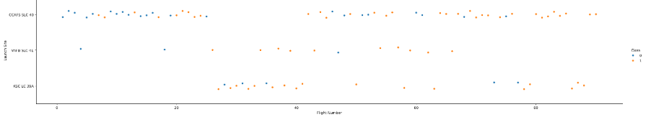
Flight Number vs. Launch Site
Scatter plot below show the plot of flight number vs launch sites:
Total number of launches from CCAFS SLC 40 were the highest among the other sites
Falcon 9 first stage launch in CCAFS SLC had achieved the greatest number of continuously success among the sites.

Slide 19
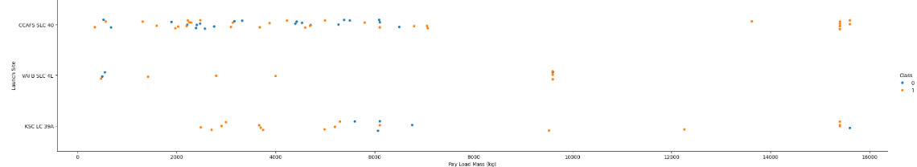
Payload vs. Launch Site
Scatter plot below show the plot of Payload vs launch sites:
Success rate increase along with payload mass, the successful stage 1 landing rate increase whe the payload increases over 8000 kg and before 16000 kg

Slide 20
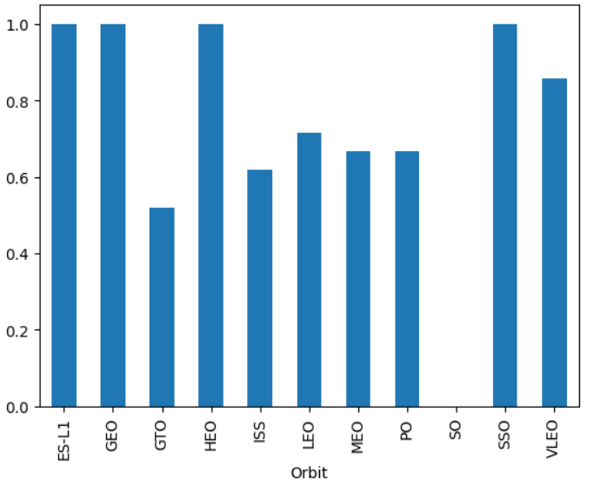
Success Rate vs. Orbit Type
ES-L1, GEO, HEO and SSO have the 100% success rate of landing of stage 1
Meanwhile, SO has no successful first stage landing

Slide 21
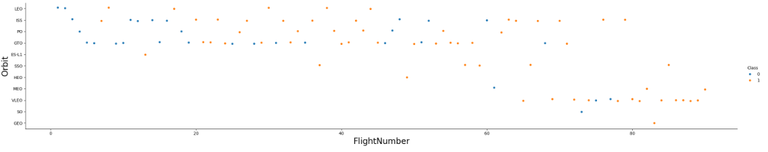
Flight Number vs. Orbit Type
Scatter plot below show the plot of flight number vs orbit type:
The larger the flight number the higher the success rate of successful stage 1 landing

Slide 22
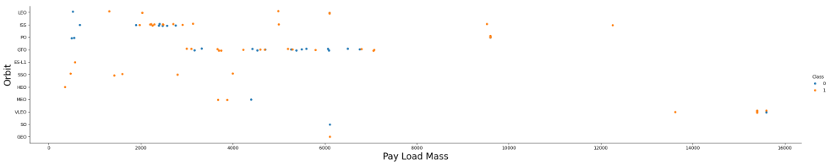
Payload vs. Orbit Type
Scatter plot below show the plot of payload vs orbit type:
Success rate appeared to have no obvious correlation with payload mass.

Slide 23
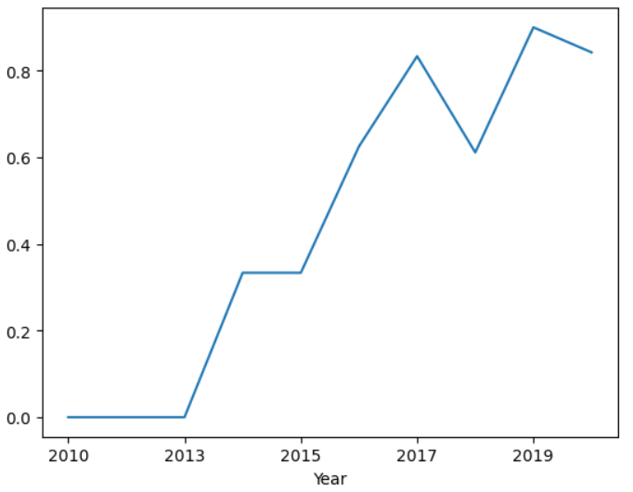
Launch Success Yearly Trend
Scatter plot below show the plot of launch success vs yearly trend:
The success rate of the Falcon 9 first stage landings has increased significantly over the selected interval of years.

Slide 24
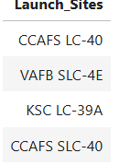
All Launch Site Names
Question : Find the names of the unique launch sites
Query : %sql SELECT DISTINCT LAUNCH_SITE as "Launch_Sites" FROM SPACEXTBL;
Explanation: Filter the unique launch sites, and there are only 4 sites
Result:

Slide 25
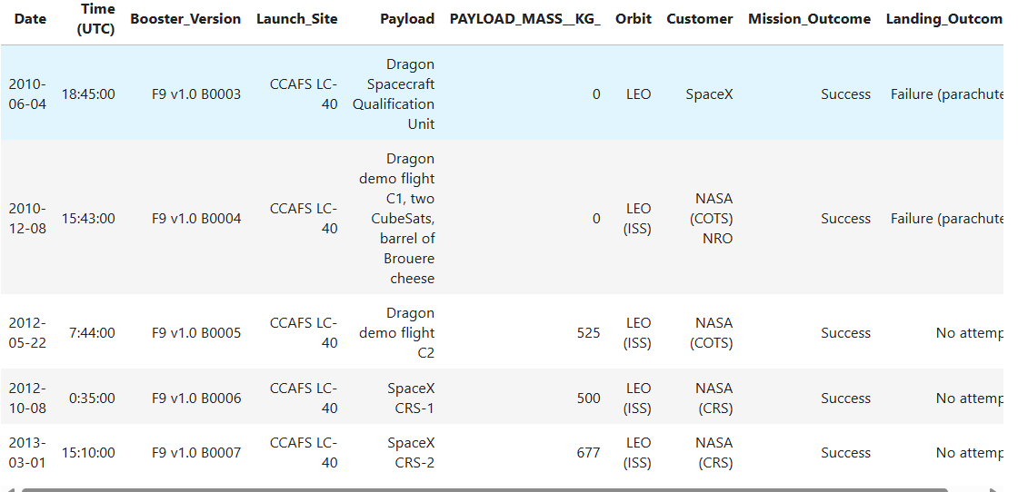
Launch Site Names Begin with 'CCA'
Question : Find 5 records where launch sites begin with `CCA`
Query : %sql SELECT * FROM 'SPACEXTBL' WHERE Launch_Site LIKE 'CCA%' LIMIT 5;
Explanation: Filter data without knowing the full naming of the names
Result:

Slide 26
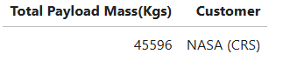
Total Payload Mass
Question : Calculate the total payload carried by boosters from NASA
Query : %sql SELECT SUM(PAYLOAD_MASS__KG_) as "Total Payload Mass(Kgs)", Customer FROM 'SPACEXTBL' WHERE Customer = 'NASA (CRS)';
Explanation: filter data with specific customer and total payload
Result:

Slide 27
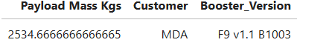
Average Payload Mass by F9 v1.1
Question : Calculate the average payload mass carried by booster version F9 v1.1
Query : %sql SELECT AVG(PAYLOAD_MASS__KG_) as "Payload Mass Kgs", Customer, Booster_Version FROM 'SPACEXTBL' WHERE Booster_Version LIKE 'F9 v1.1%’;
Explain: Using AVG function to calculate the average
Result:

Slide 28
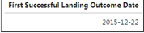
First Successful Ground Landing Date
Question: Find the dates of the first successful landing outcome on ground pad
Query: SELECT min(`DATE`) AS "First Successful Landing Outcome Date" FROM `SPACEXDATASET` WHERE `landing__outcome` LIKE ‘Success (ground pad)’
Explanation: using min(date) to find the earliest date among the data.
Result:

Slide 29
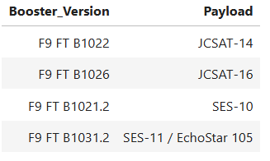
Successful Drone Ship Landing with Payload between 4000 and 6000
Question : List the names of boosters which have successfully landed on drone ship and had payload mass greater than 4000 but less than 6000
Query : %sql SELECT DISTINCT "Booster_Version", "Payload" FROM SPACEXTBL WHERE "Landing_Outcome" = "Success (drone ship)" AND "PAYLOAD_MASS__KG_"> 4000 AND "PAYLOAD_MASS__KG_"<6000;
Explanation: using “and” function to filter the in between value.
Result:

Slide 30
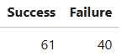
Total Number of Successful and Failure Mission Outcomes
Question: Calculate the total number of successful and failure mission outcomes
Query: %sql SELECT (SELECT count(*) FROM SPACEXDATASET WHERE lcase(landing__outcome) LIKE '%success%') AS "Success", count(*) AS "Failure" FROM SPACEXDATASET WHERE lcase(landing__outcome) NOT LIKE '%success%’;
Explanation: Present your query result with a short explanation here
Result:

Slide 31
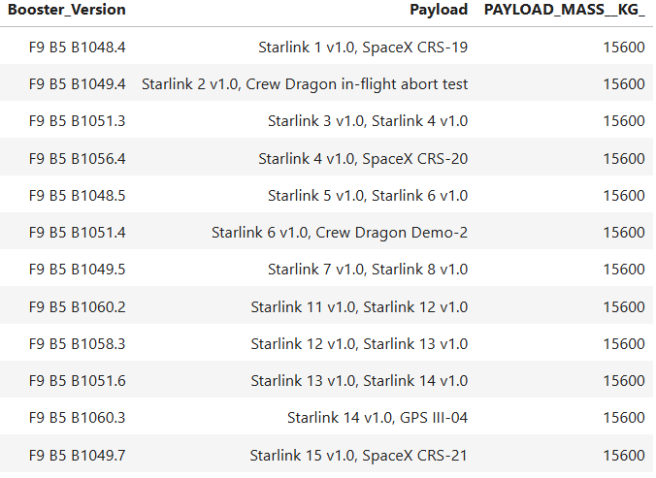
Boosters Carried Maximum Payload
Question: List the names of the booster which have carried the maximum payload mass
Query: %sql SELECT "Booster_Version","Payload", "PAYLOAD_MASS__KG_" FROM SPACEXTBL WHERE "PAYLOAD_MASS__KG_" = (SELECT MAX("PAYLOAD_MASS__KG_") FROM SPACEXTBL);
Explanation: using “MAX” Function to select the maximum value
Result:

Slide 32
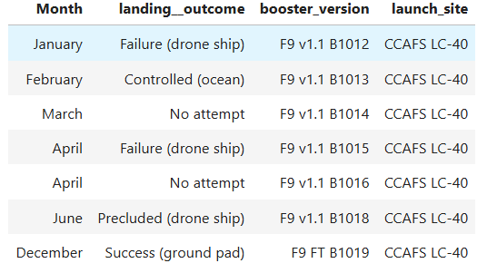
2015 Launch Records
Question: List the failed landing_outcomes in drone ship, their booster versions, and launch site names for in year 2015
Query: %sql SELECT MONTHNAME(DATE) AS "Month", landing__outcome, booster_version, launch_site FROM SPACEXDATASET WHERE YEAR(DATE) = 2015;
Explanation: by using “=“ function to filter the exact value
Result:

Slide 33
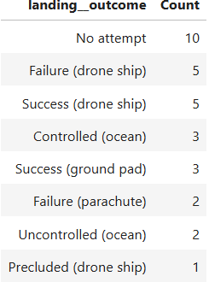
Rank Landing Outcomes Between 2010-06-04 and 2017-03-20
Question: Rank the count of landing outcomes (such as Failure (drone ship) or Success (ground pad)) between the date 2010-06-04 and 2017-03-20, in descending order
Query : %sql SELECT landing__outcome, count(landing__outcome) AS "Count" FROM SPACEXDATASET WHERE DATE BETWEEN '2010-06-04' AND '2017-03-20' GROUP BY landing__outcome ORDER BY count(landing__outcome) DESC;
Result:

Slide 34

Section 3

Slide 35
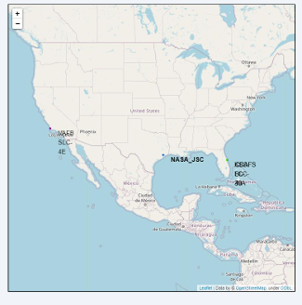
Falcon 9 Launch Sites
All launch location are pin with name on the map

Slide 36
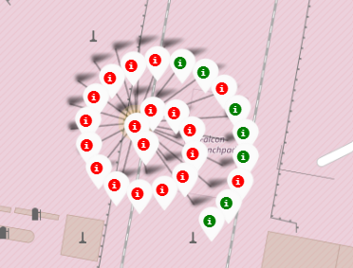
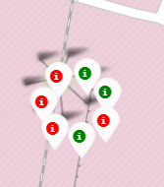
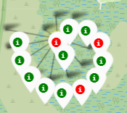
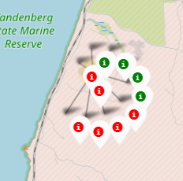
Success/Failure Attempt at Each Site
CCAFS LC-40
CCAFS SLC-40
KSC LC-39A
VAFB SLC-4E
The markers display the mission outcomes (Success/Failure) for Falcon 9 first stage landings. They are grouped on the map to be associated with the geographical coordinates for the launch site
A sense of a launch site’s success rate for Falcon 9 first stage landings can be gleaned from the relative number of green success markers to red failure markers.

Slide 37
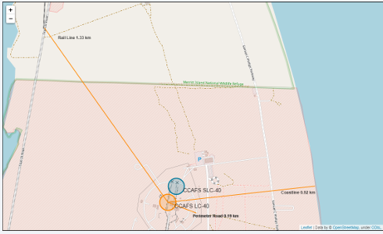
Relation between Launch Site and Proximities
The CCAFS LC-40 and CCAFS SLC-40 launch sites have coordinates that are close to being, but are not exactly, right on top of each other.
The perimeter road around CCAFS LC-40 is 0.19 km away from the launch site coordinates.
The coastline is 0.92 km away from CCAFS LC-40.
The rail line is 1.33 km away from CCAFS LC-40.

Slide 38

Section 4

Slide 39
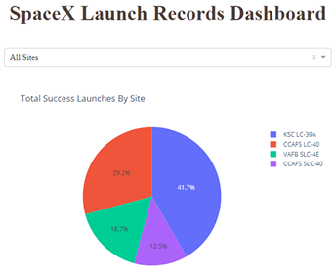
SpaceX Launch Records Dashboard
Figure shown the records of successful launches at all sites by pie chart
KSC LC-39A had the highest successful launches among all the sites which had the 41.7% success rate.
CCAFS SLC-40 had the lowest success rate among the sites, which only had 12.5%

Slide 40
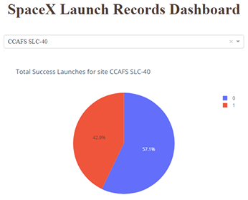
Highest Launch success ratio
Falcon 9 first stage failed landings are indicated by the ‘0’ Class (■ blue wedge in the pie chart) and successful landings by the ‘1’ Class (■ red wedge in the pie chart).
CCAFS SLC-40 was the launch site that had the highest Falcon 9 first stage landing success rate (42.9%).

Slide 41
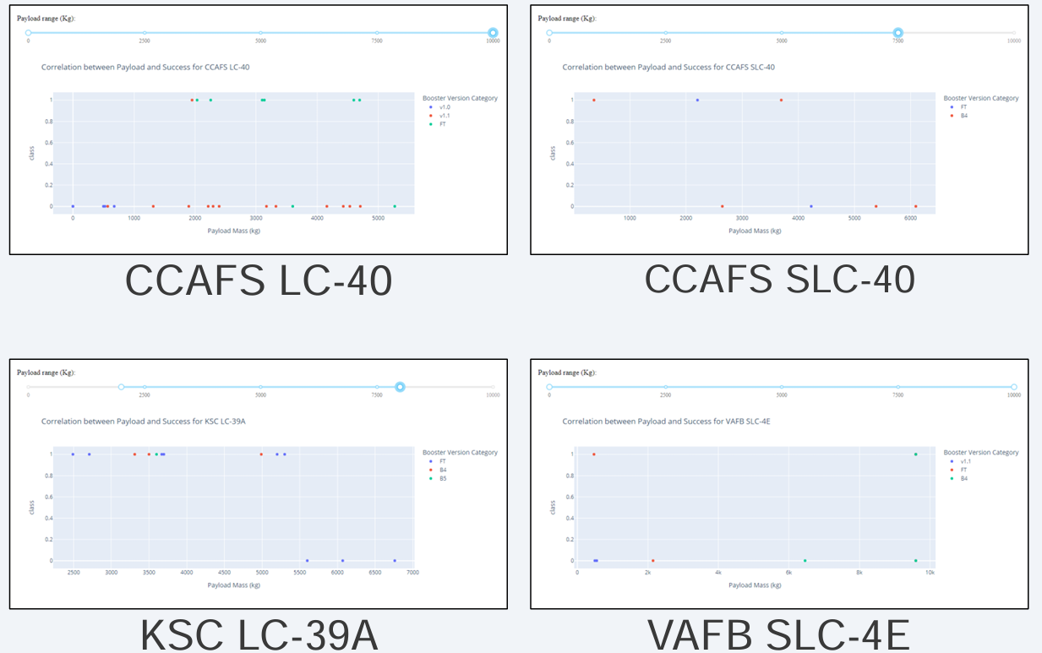
Payload vs Outcome
These screenshots are of the Payload vs. Launch Outcome scatter plots for all sites, with different payload selected in the range slider.
The payload range from about 2,000 kg to 5,000 kg has the largest success rate.
The ‘FT’ booster version category has the largest success rate

Slide 42

Section 5

Slide 43
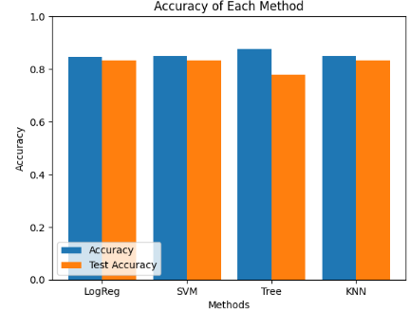
Classification Accuracy
3 model LogReg , SVM and KNN model had highest and equally accuracy. On the other hand, Decision Tree model had performed the worst accuracy.

Slide 44
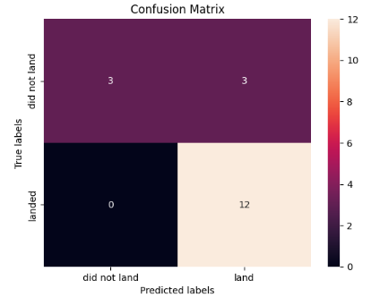
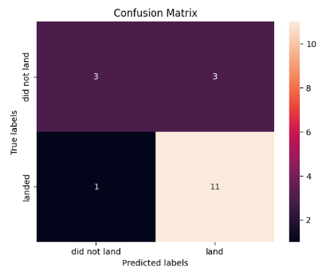
Confusion Matrix
Shown here is the confusion matrix for the Logistic Regression model.
Confusion matrices can be read as:
Based on 4 confusion matrix, tree has the greatest number of false negative among model.
True Negative | False Positive
False Negative | True Positve
LogReg
Tree
SVM
KNN

Slide 45
Conclusions
LR, SVM, KNN are top-performing models for forecasting outcomes in this data
Lighter payloads have a higher performance compared to heavier ones.
The likelihood of a SpaceX launch succeeding increases with the number of years of experience, suggesting a trend towards flawless launches over time.
Launch Complex 39A at Kennedy Space Center has the highest number of successful launches compared to other launch sites.
GEO,HEO,SSO,ES L1 orbit types exhibit the highest rates of successful launches

Slide 46


